Slide 1
Putting users first
European Data Users' Conference
Sofia, 25 June 2018
Mariana Kotzeva
Director-General
Eurostat

Slide 2
The European Statistical System (ESS)
A partnership between Eurostat, all national statistical institutes and other national authorities

Slide 3
How does this partnership work?
National statistical offices
Collect and verify data, send them to Eurostat
Eurostat
Consolidates data
Produces European aggregates
Publishes official statistics for Europe (European statistics)

Slide 4
Challenges for official statistics
Better measure emerging phenomena and globalisation
Make the most of digital technologies and new data sources
Communicate effectively and make official statistics better known
Intensify cooperation and build partnerships at international level

Slide 5
Producing high-quality statistics is not enough
Our products and services
need to be visible and attractive

Slide 6
What do users expect from us?
Easily accessible
Interactive
European statistics to be:
Easy to understand
Reusable

Slide 7
Different users with different needs
Businesses
European citizens
European institutions
Researchers
Policy makers
Media

Slide 8
However, there is no 'one-size-fits-all' solution

Slide 9
Our response
Revamped website and data base
Daily news section
Investment in social media
Digital publications
Interactive data visualisations
Direct contact with our users

Slide 10
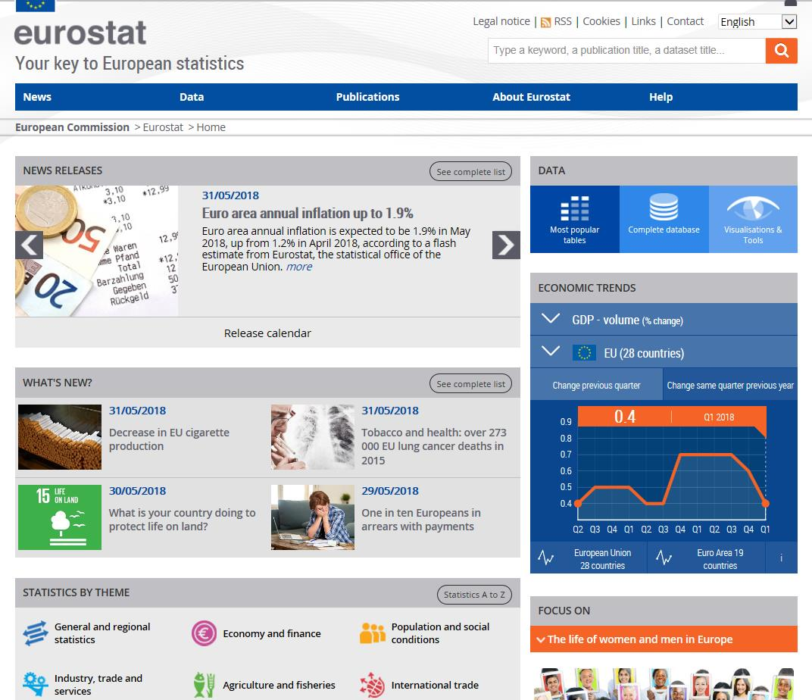
Revamped Eurostat website featuring daily news

Slide 11
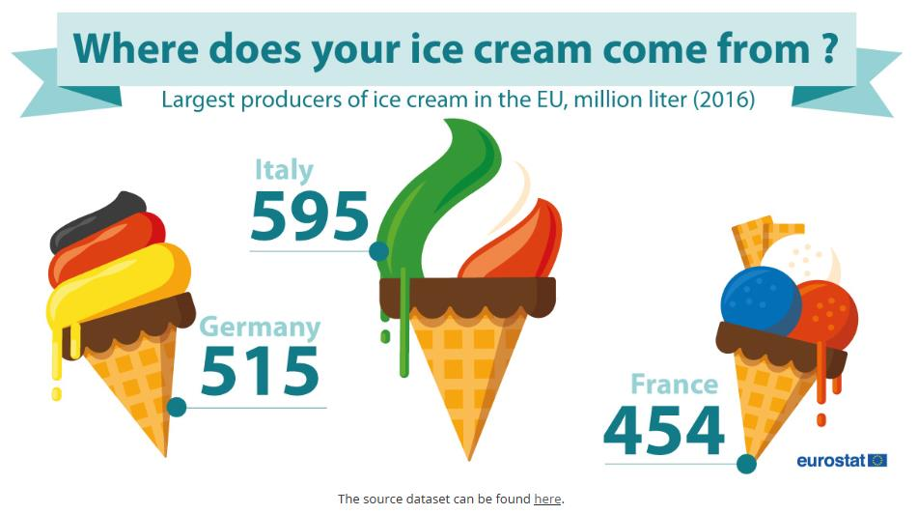
Replicated by international news outlets

Slide 12
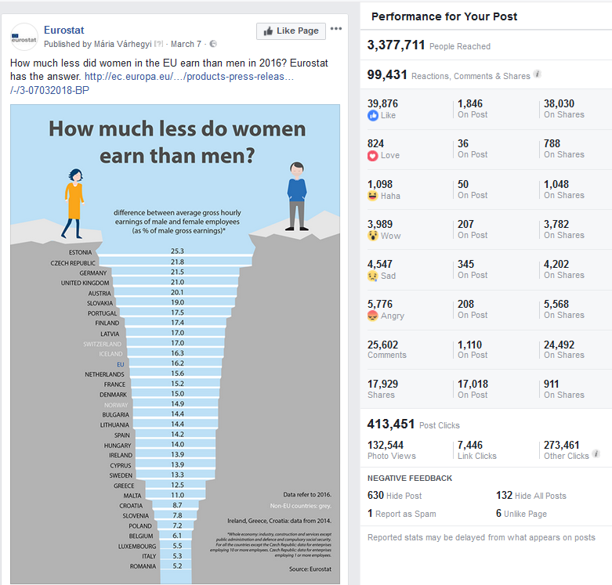

Slide 13
Developing interactive infographics

Slide 14
Modernising our publications: going digital

Slide 15
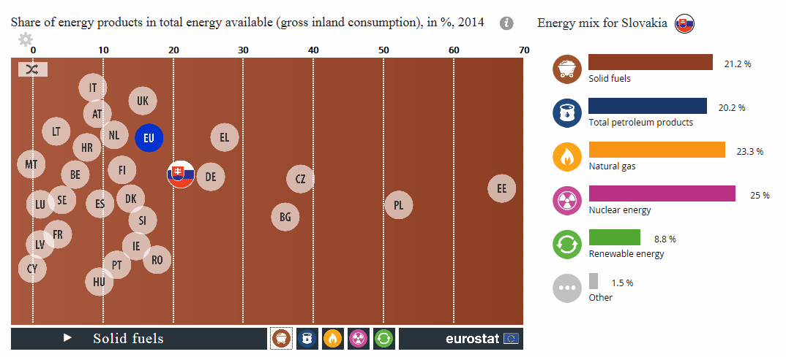
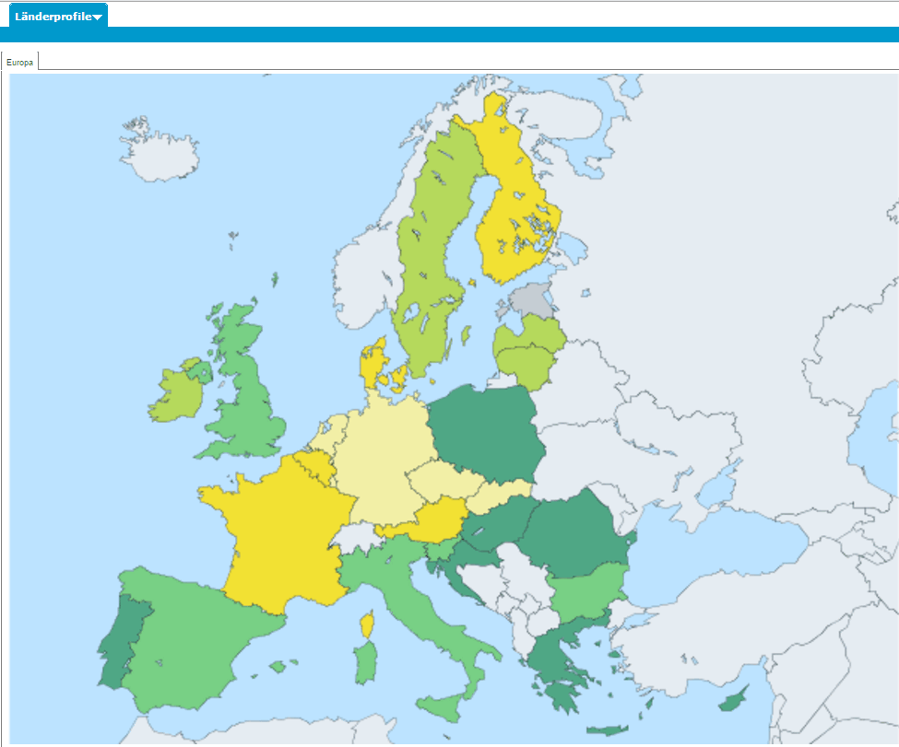
Interactive tools

Slide 16
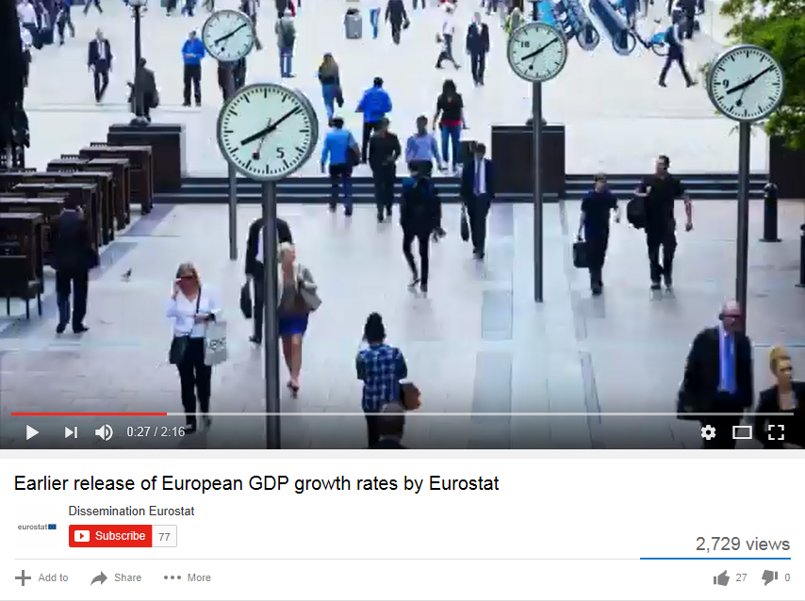
Using videos to explain and promote
our new products

Slide 17
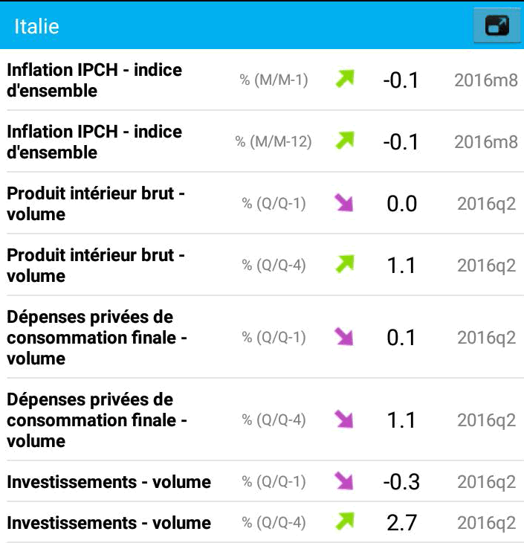
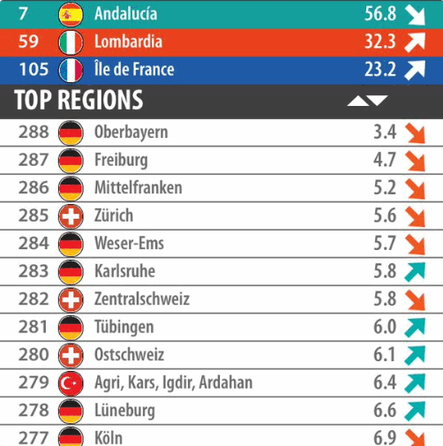
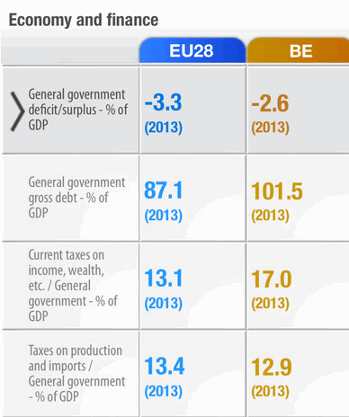
Being present where users are
Eurostat apps
EU Economy
My Region
Country profiles

Slide 18
Testing new products with users
Conceptualisation
Design
Development
Impact measurement
Idea
User test of concept
Internal validation
Prototype development
Usability and design testing
Internal validation
Product finalisation and publication
Online monitoring

Slide 19
Working together within the ESS
1. User research
Testing products with users
2. Visualisation and digital products
3. Open data dissemination
4. Statistical literacy, communication

Slide 20
Sharing tools: a success story in Bulgaria

Slide 21
A large impact on TV and radio

Slide 22
Teach users about statistics:
statistical literacy
European Statistics Olympics
school year 2017-2018
Statistics4beginners - Eurostat website
Massive open online course (MOOC): planned cooperation with Committee of the Regions

Slide 23
What next?
Fast changing data to reflect evolving needs of our users
Post-truth environment – objective facts less influential in shaping public opinion than emotions or personal beliefs
Lack of trust can lead to misuse of statistics
Making statistics closer to citizens

